Slide 1

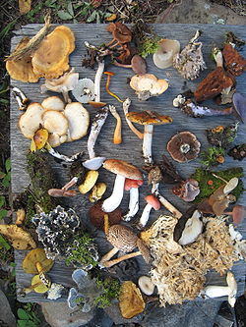
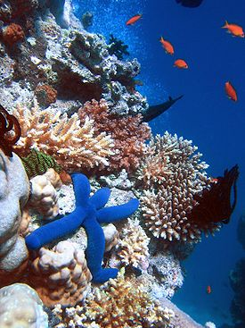
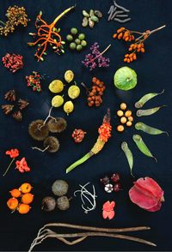
(Management Topic in Environmental Studies)
B. Tech 7TH Semester
BIODIVERSITY (PART-2)
Department: Chemistry
Subject: MTES (CHM2049)

Slide 2

Contents
Threats to Biodiversity
Endangered and Endemic Species in India
Red Data Book Classification of Wildlife
Conservation of Biodiversity
Organizations Working for Protection of Biodiversity
Notes:
2

Slide 3
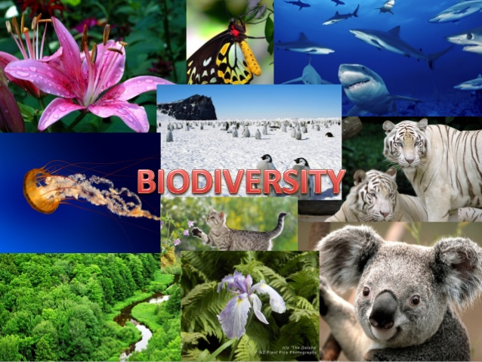
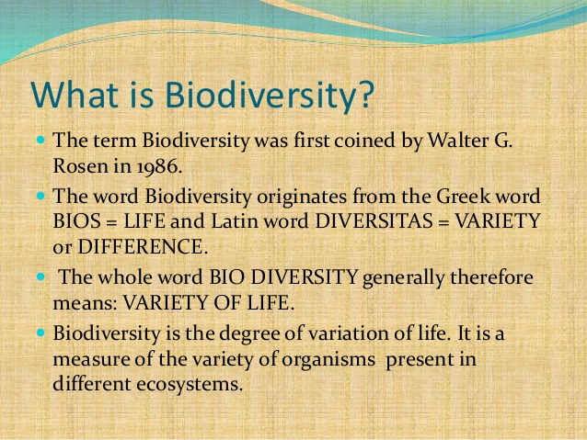
What is Biodiversity
Biodiversity: It is concerned with the variety of individuals within populations, the diversity of species within communities, and the range of ecological roles within ecosystems

Slide 4
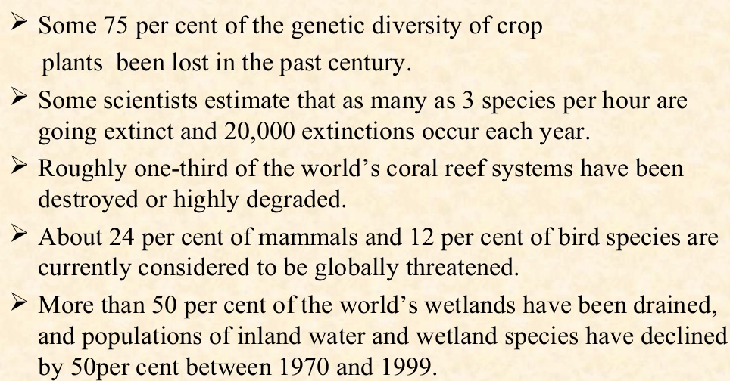
Recent Issues on Biodiversity
One of the estimates by the noted ecologist, E.O. Wilson puts the figure of extinction at 10,000 species per year or 27 per day

Slide 5
THREATS TO BIODIVERSITY
There are different threats to biodiversity because of which their population is going on decreasing day by day. The threats may be natural on anthropogenic. Some of the causes are discussed below;
HABITAT LOSS, DEGRADATION, FRAGMENTATION.
Causes of habitat loss: Agriculture activities, Mining, large Hydro power plants, Urbanization and industry etc.
Habitat loss & degradation are major causes of species extinction, affecting
89% of all threatened birds,
83% of mammals &
91% of all threatened plants assessed globally (IUCN, 2000).
2. POACHING OF WILDLIFE
  Poaching is another threat that has emerged in recent decades as one of the primary reason for decline in number of species.
  Illegal wild life trade
  Wildlife is sold and traded in many countries for i) live specimens, ii) folk medicines, iii) furs, skin, and other products such as Ivory, horns etc amounting to millions of dollars.

Slide 6
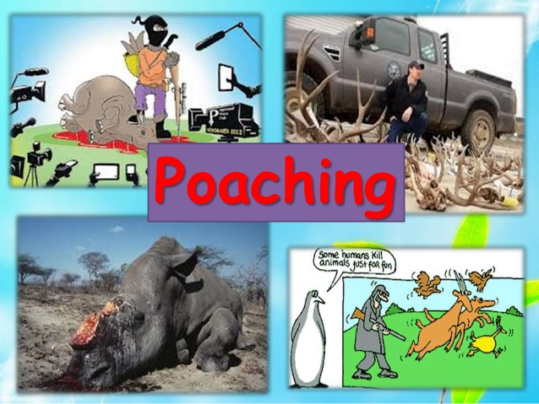
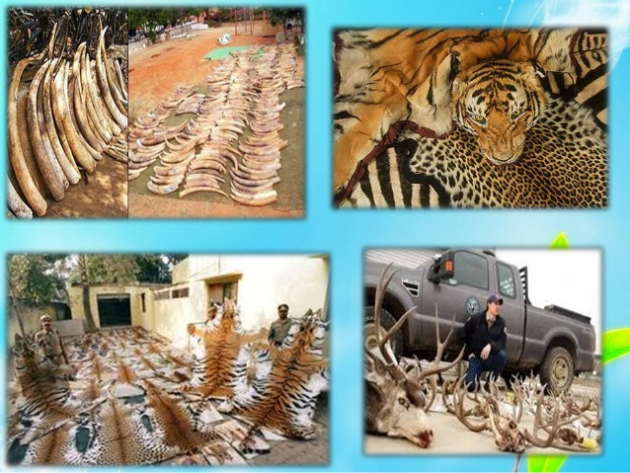
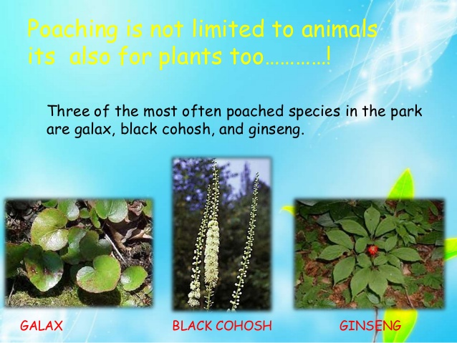
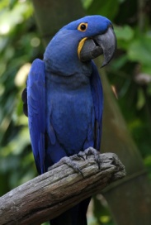
THREATS TO BIODIVERSITY
Poaching is not limited to animals its also for plant
The cost of elephant tusks
can go upto $ 100 per kg; the leopard fur coat is sold at $ 100,000 in Japan
$ 10,000 for a rare hyacinth macaw , a beautiful coloured bird, from Brazil.
Menopause problem,
Black Cohosh)
Mental disease, Low BP,
Diabetes (Ginseng)

Slide 7
THREATS TO BIODIVERSITY
3. MAN – WILDLIFE CONFLICTS
  Due to the lack of stable food, shelter and disruption of movement, wild animals came out of forest area and attack the agricultural field and humans and in turn got killed by the humans.
4. INTRODUCTION OF EXOTIC SPECIES
  Organisms introduced into new habitats where they are not native are termed as exotics are also considered as Biological Pollutants.
5. CLIMATE CHANGE AND ENVIRONMENTAL POLLUTION
  A changing global climate threatens species and ecosystems.
  The air, water and soil pollution are the major factor to extinct number of species in both terrestrial and aquatic ecosystems.
  Spread disease

Slide 8
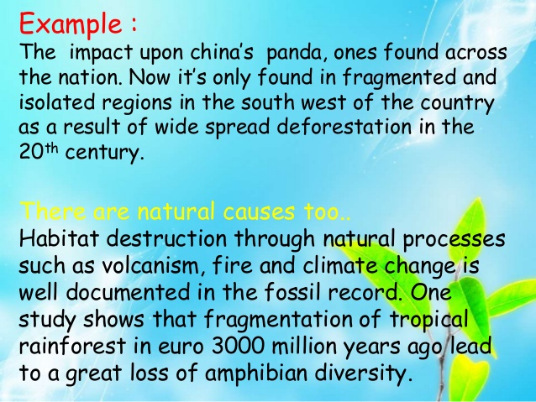
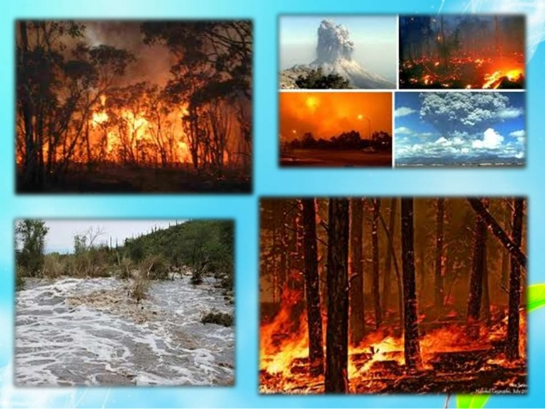

Slide 9
ENDANGERED SPECIES IN INDIA
According to The International Union of Conservation of Nature and Natural Resources (IUCN), the species that considered in imminent danger of extinction
and whose survival is unlikely, if factors causing their decline continue to operate.
Classification of plant and animal as per Red Data Book (IUCN 1964)
Endangered (E)
Vulnerable (V)
Rare (R)
Threatened (T)
Out of danger (O)
Indeterminate (I)

Slide 10
Endangered (E): Species whose numbers have been reduced to a critical level or whose habitats have been so drastically reduced that they are deemed to be in immediate danger of extinction.
Vulnerable (V): Species believed likely to move into the endangered category in the near future if the casual factors continue operating.
Rare (R): Species with, small world populations that are not at present endangered or vulnerable, but are at risk.
Threatened (T): Threatened is used in the conservation context for species which are in one of the categories Endangered, Vulnerable and Rare.
Out of danger (O): Species formerly included in one of the above categories, but which are now considered relatively secure because effective conservation measures have been taken
Inderterminate (I): Species that are suspected of belonging to one of the first three categories, but for which insufficient information is currently available.

Slide 11
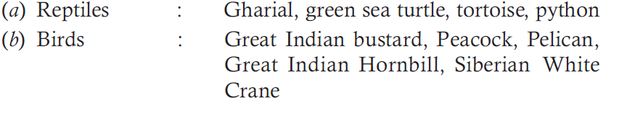
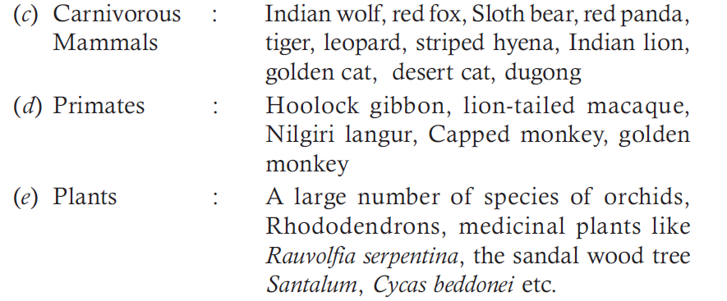
ENDANGERED SPECIES IN INDIA
450 plant species are endangered, threatened or rare in India
about 150 mammals and 150 species of birds are threatened
unknown number of species of insects are endangered
The Zoological Survey of India reported that Dudo, Passenger pigeon, Pink headed duck and mountain quail have already become extinct from India.

Slide 12
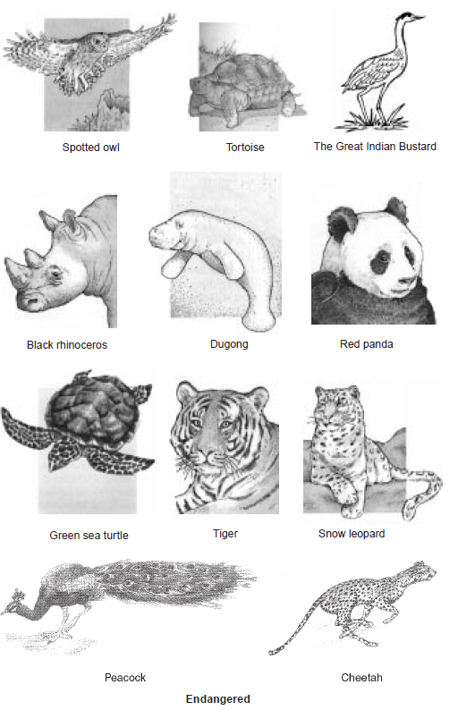
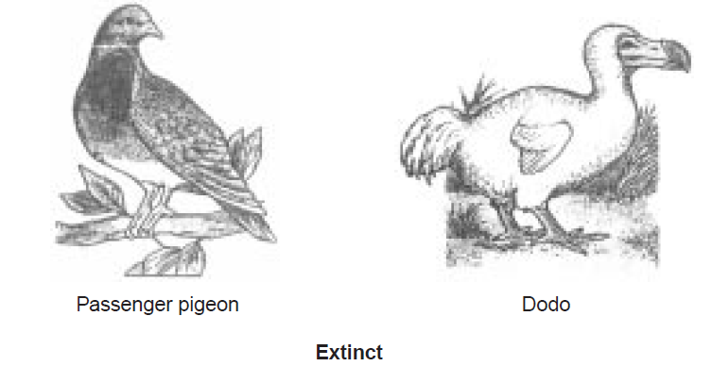
Some important endangered & extinct species
In India, 53 species of mammals, 69 birds, 23 reptiles and 3 amphibians are considered as threatened species.
As many as 3,000- 4,000 higher plants may be under high degree of threat in India.

Slide 13
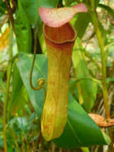
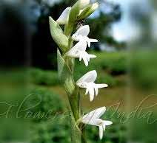
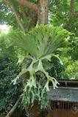
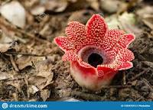
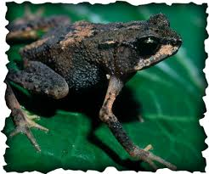
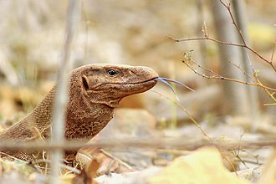
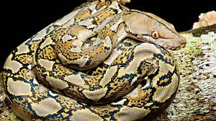
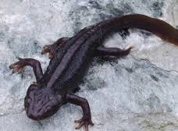
ENDEMIC SPECIES OF INDIA
Out of about 47,000 species of plants in India 7000 are endemic.
62% endemic flora, restricted mainly to Himalayas, Khasi Hills and
Western Ghats. Example:,
About 62% amphibians and 50% lizards are endemic to Western Ghats.
Different species in India as below
Nepenthes khasiana
Trooth brush Orchid
Platycerium alcicorne
Sapria himalayana
Indian Salamander
Viviparous toad
monitor lizards
Reticulated python

Slide 14
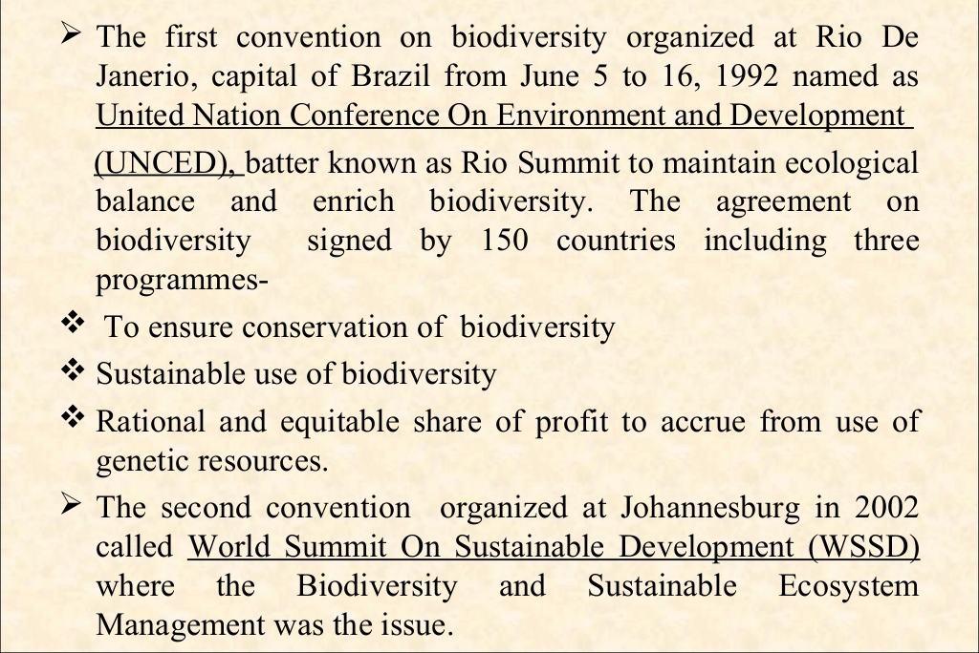
Biodiversity Convensions

Slide 15
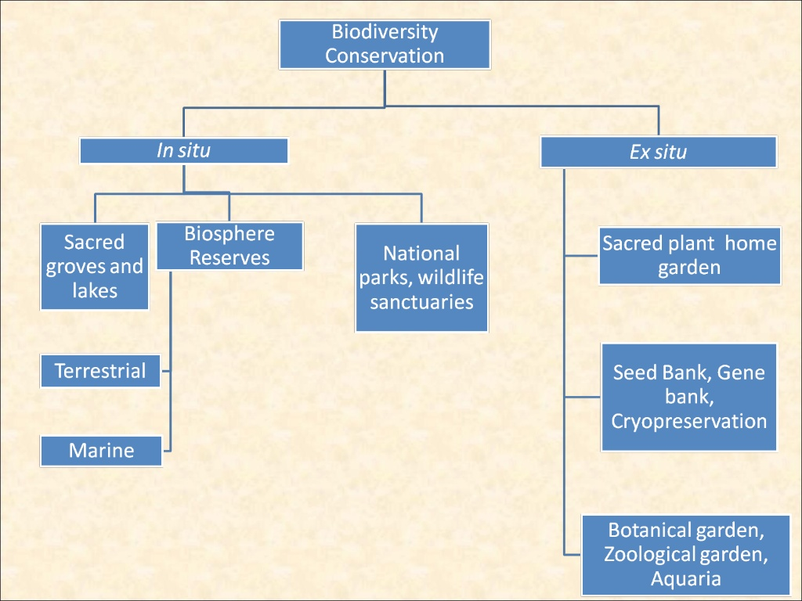
CONSERVATION OF BIODIVERSITY
  Conservation is defined as “the management of human use of the biosphere so that it may yield the greatest sustainable benefit to the present generation while maintaining its potential to meet the needs and aspirations of the future generations”.
(a) In situ conservation (within natural habitat): protection of wild flora and fauna in nature itself.
(b) Ex situ conservation (outside habitats)

Slide 16
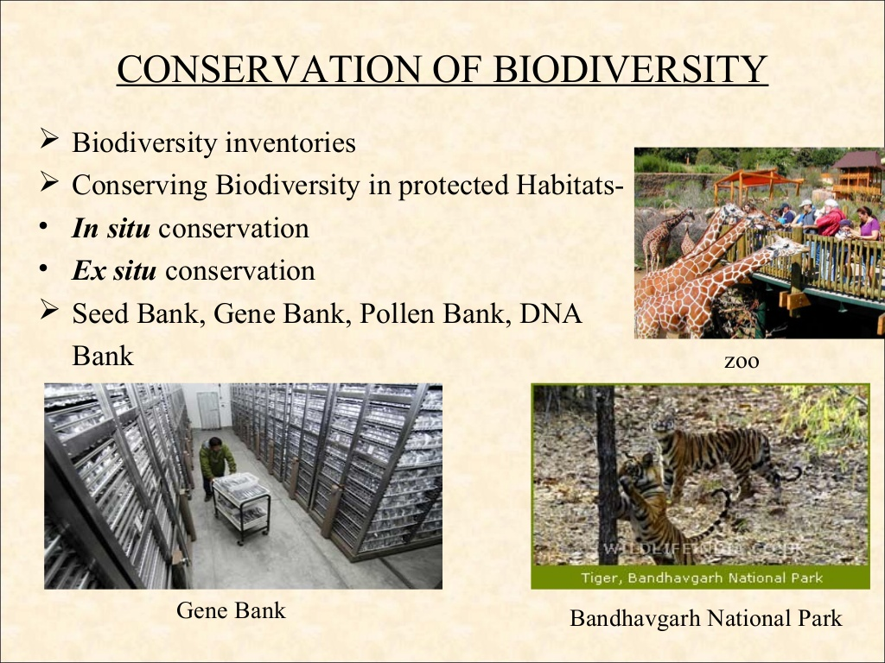
In- Situ conservation
It simply means conservation of species in its natural ecosystem or habitat through a network of “protected area”.diversity and managed through legal effective means.
At present we have 7 major Biosphere reserves, 80 National Parks, 420 wild-life sanctuaries and 120 Botanical gardens in our country covering 4% of the geographic area.
These include:-
Biosphere reserves
National parks
Wild Life Sanctuaries etc.

Slide 17
Biosphere Reserves have been described as undisturbed natural areas for scientific study as well as areas in which conditions of disturbance are under control. These serve as the centre for ecological research and habitat protection, The "Biosphere Reserve consists of two main zones as:
as a whole for long-term in situ conservation.
Core zone (undisturbed area)
2. Buffer zone( open for tourism)
. Objectives :
• Conserve biological diversity
• Safeguard genetic diversity
• Provide areas for basic and applied research
• Opportunity for Environmental Science and training
• Promote international cooperation
• Promote management of biotic resources.
Preserve and protection of local tribal people
Biosphere
Indian Government has established 18 Biosphere Reserves
Nanda Devi (U.P.), Nokrek (Meghalaya), Manas (Assam), Sunderbans (West Bengal), Gulf of Mannar (Tamil Nadu), Nilgiri (Karnataka, Kerala, Tamil Nadu), Great Nicobars and Similipal (Orrisa) biosphere Reserves.

Slide 18
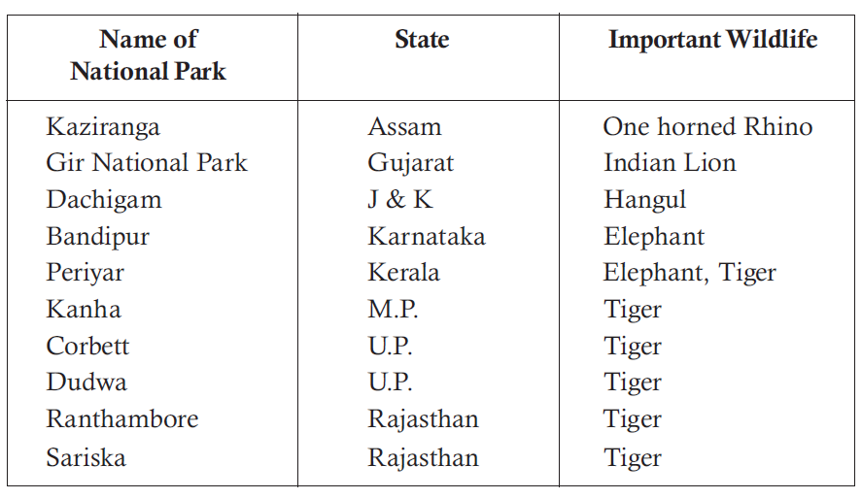
National park in India
A National Park is an area dedicated for the conservation of wildlife along with its environment facilitate truism
Grazing of domestic animals, all private rights and forestry activities are prohibited
. conservation specifically of some particular species of wildlife along with others.
India’s first national park was established in 1936 as Hailey National Park, now known as Jim Corbett National Park.

Slide 19
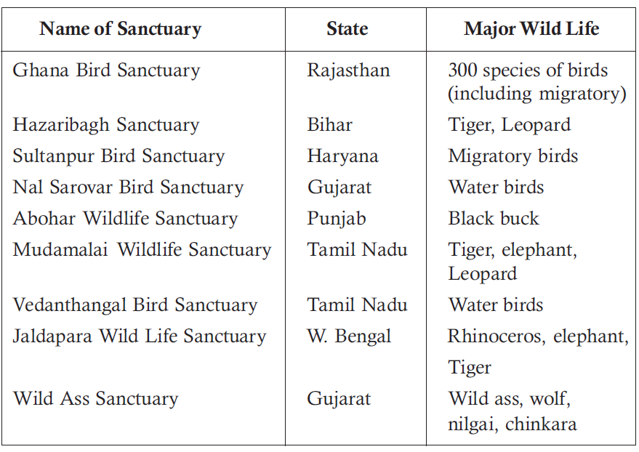
Wildlife sanctuary
The Indian Board for Wild Life has defined a sanctuary as, 'An area where killing, hunting, shooting or capturing of any species of bird or animal is prohibited except by or under the control of highest authority in the department responsible for the management of the sanctuary and whose boundaries and character should be very important as far as possible.
Some major wildlife sanctuaries of our country
Private ownership rights are permissible and forestry operations are also permitted to an extent that they do not affect the wildlife adversely

Slide 20
Sanctuary
For plants, there is one gene sanctuary for Citrus (Lemon family) and one for pitcher plant (an insect eating plant) in Northeast India.
Project for the protection and conservation of certain animals, e.g.
Project Tiger, Gir Lion Project,
Crocodile Breeding Project,
Project Elephant,
Snow Leopard Project

Slide 21
Ex- Situ conservation
It is defined as “the conservation of component of biological diversity (Sample of genetic diversity, particularly of endangered species) outside their natural habitats”.
Botanical/ zoological gardens, aquarium and research centre.
There are more than 1500 Botanical gardens in the world containing more than 80,000 species. There are more than 800 zoos around the world with about 3,000 species of mammals, birds, reptiles and amphibians.
National Bureau of Plant Genetic Resources (NBPGR) New Delhi. Here agricultural and horticultural crops and their wild relatives are preserved by cryo-preservation of seeds, pollen etc. by using liquid nitrogen at a temperature as low as -196°C.
(iii) National Bureau of Animal Genetic Resources (NBAGR) Karnal, Haryana. It preserves the semen of domesticated bovine animals.
(iv) National Facility for Plant Tissue Culture Repository (NFPTCR) for the development of a facility of conservation of varieties of crop plants/trees by tissue culture.

Slide 22
Thank You

